Slide 1

DriverPass System Analysis
Jonathan Carmichael
Notes:
[No speaker notes required for this slide.]

Slide 2

System Requirements
Functional Requirements:
The system should allow users to register/login when given the proper information
The system should be connected via the DMV, displaying the most recent rules and policies, as well as practice sample questions for customers
Nonfunctional Requirements:
The app will require storage for the database/website data
Users should be able to reset their site password, if forgotten
Notes:
DriverPass should allow users to register themselves and/or login to their connected accounts. Of course, all users will need to enter the correct information to create an account (username, email, and password). Afterwards, the can login to buy packages, schuedule appoints with our drivers, as well as study via the updated DMV documents on the DriverPass site. This is just one example of the many functional requirements DriverPass has to run properly.
As for nonfunctional requirements, the website needs internal (as well as external) storage to save all website and database information. The user needs to be able to have their data stored properly, so that next time they log in, it’s all still there. The users should also be able to reset their own passwords. Through email, the system can verify them, and employees should be able to assist users with resetting their passwords in case the forget. The employees can send them reset links, so they don’t need to reset the user’s password each time, individually.

Slide 3
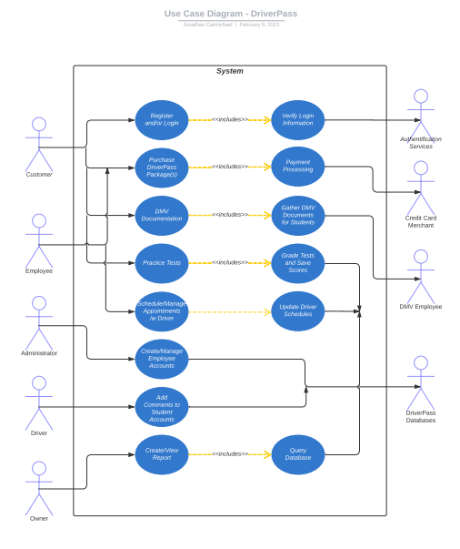
Use Case Diagram
Notes:
This diagram is used to showcase how certain individuals will utilize certain functions in the DriverPass site. There is the customer, employee, administrator, driver, and owner that will directly use the site. The customer needs access to functions like creating an account, purchasing packages, and accessing their documentation. The employee is there to assist the customer in setting up appointments and purchasing packages for them. The administrator manages the employee accounts and their functions. The driving instructor is there to teach the customers. They can add comments to the customer’s driving. And lastly, the owner is able to create and view reports.
There are also functions that the user won’t be able to see. There happen in the background of the site. These include login verification through an authentication service, as well as processing user payments through a credit card merchant. The DMV will also be providing the most up-to-date official documentation for customers to study from. Also, the DriverPass database stores all information for later reporting purposes.

Slide 4
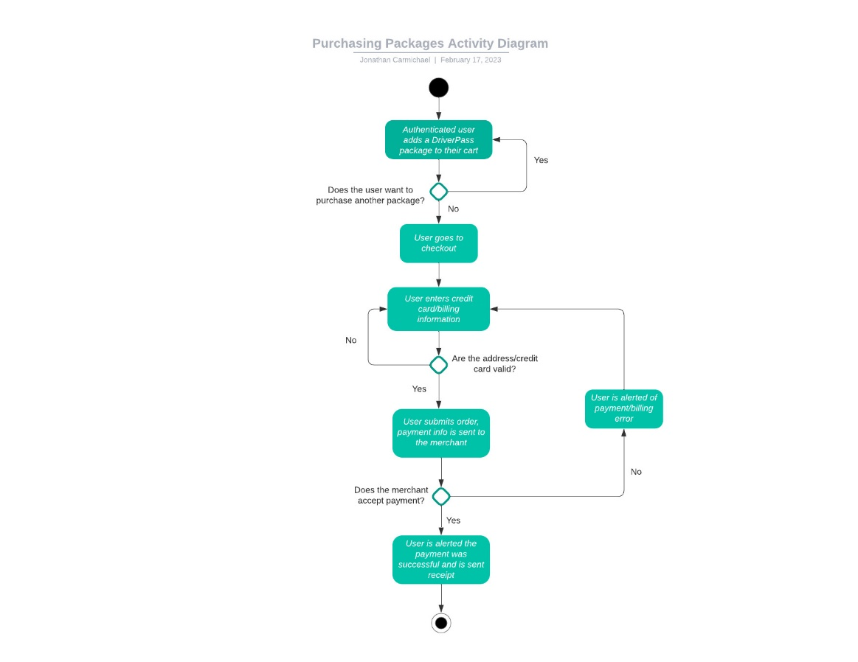
Activity Diagram
Notes:
This activity diagram breaks down the purchasing of packages done by customers on the DriverPass site. Firstly, the authenticated user will choose the package that they want to buy. They will then be prompted if they want to purchase additional packages. If so, they will be able to do so. If not, the user is sent to the checkout screen. From there, the user will enter their credit card and billing information that will be validated by the site for processing. If the address and card information are valid, the user will be able to submit the order. If not, they are prompted again to enter correct information. Following submission, the payment will be sent to the CC merchant to be accepted or not. If not, the user will be alerted that there was an error running their payment and asked to enter their card/billing info again. However, if it is processed successfully, the user is alerted of this and is sent a receipt via their e-mail.
This is a simple, straight-forward process for allowing user’s to purchase DriverPass packages and pay for them as well.

Slide 5
Security
Users require a user ID and password to be able to log in
Registered users must authenticate their e-mail address
Max tries limit. This authentication process stops hackers from easily logging on to user accounts
The site uses HTTPS (instead of HTTP) to protect sensitive information through encryption
Notes:
Alongside the normal, standard ways users normally log in to accounts nowadays (username and password), e-mail authentication is a great way to help stop bot accounts from being created, as well as helping defend against hackers. We can “block” accounts after a certain amount of incorrect login attempts. The user can contact support for further assistance. This is helpful against “brute force” attacks from hackers. Hackers will typically use a script to guess a password, but that can take many attempts before success. Lastly, the site will utilize HTTPS over HTTP, which can protect sensitive data (credit card numbers and user information) by encrypting it. This, again, protects against hackers, making it harder for them to steal information/data.

Slide 6
System Limitations
Clientele in certain regions may have a slower connection, or no access to the site
There’s no guarantee that all clientele will be able to open the website accordingly
Website security may only go so far, and certain hacking attempts may be beyond IT’s control
Adding or removing modules for a different release
Notes:
The data center for DriverPass is in the U.S., which could make customers in other regions have a slower connection to the website. They should still be able to access the site, but it’s likely to be somewhat slower. Going alongside this, depending on where clientele are located, could make it difficult for certain browsers/devices to access the site. Security is absolutely beneficial to the safety of the site. However, depending on the severity of the attack, it could be beyond IT’s control or experience. Lastly, DriverPass doesn’t have an on-staff developer. This can be an issue if they want to change/update/remove certain modules for various releases.

